Slide 1
E-commerce Project
ITMS 428/528 Final Project – Database Security● Fall 2021
Presented on November 29th 2021

Slide 2
Team Members
Rajkumar Arunachalam
Martina Dimitrova
Yannick Massivi
David Ngige
Hashmitha Shantharam
David Singer
Chanukah Wijeratne

Slide 3
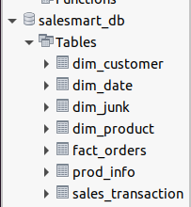
Creating the Database
We have chosen an E-commerce Data with 7 Table and with 10000+ Entries.
Database Name : salesmart_db
The Tables are: dim_customer - To get Customer details
dim_date - To get details of Date dim_junk - Combine Miscellaneous information fact_orders - Order Details prod_info - Product details sales_transaction - Sales details

Slide 4
Access Controls
AC-2 ACCOUNT MANAGEMENT
AC-5 SEPARATION OF DUTIES
AC-8 SYSTEM USE NOTIFICATION
AC-7 UNSUCCESSFUL LOGON ATTEMPTS
AT-4 SECURITY TRAINING RECORDS
AU-8 TIME STAMPS
CA-5 PLAN OF ACTION AND MILESTONES

Slide 5
AC-2 ACCOUNT MANAGEMENT

Slide 6
AC-2 ACCOUNT MANAGEMENT
Assigns account managers for information system accounts
Establishes conditions for group and role membership
Specifies authorized users of the information system, group and role membership, and access authorizations and other attributes for each account
Requires approvals by the project manager to create information system accounts
Creates, enables, modifies, disables, and removes information system accounts in accordance with the organizational rules
Reviews accounts for compliance with account management requirements two times a month; and establishes a process for reissuing shared/group account credentials (if deployed) when individuals are removed from the group.

Slide 7
ACCOUNT MANAGERS
The account management will be maintained by the admins (account managers)
The account managers will have administrative rights to create, delete, or modify a user account depending on the conditions of which the account change should be done
Will maintain and review informational accounts two times every month, making sure that the accounts are used in a suitable way

Slide 8
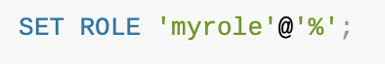
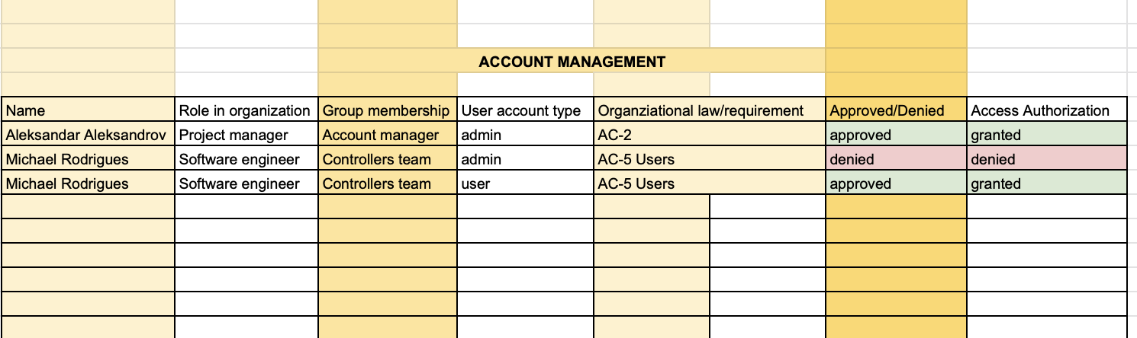
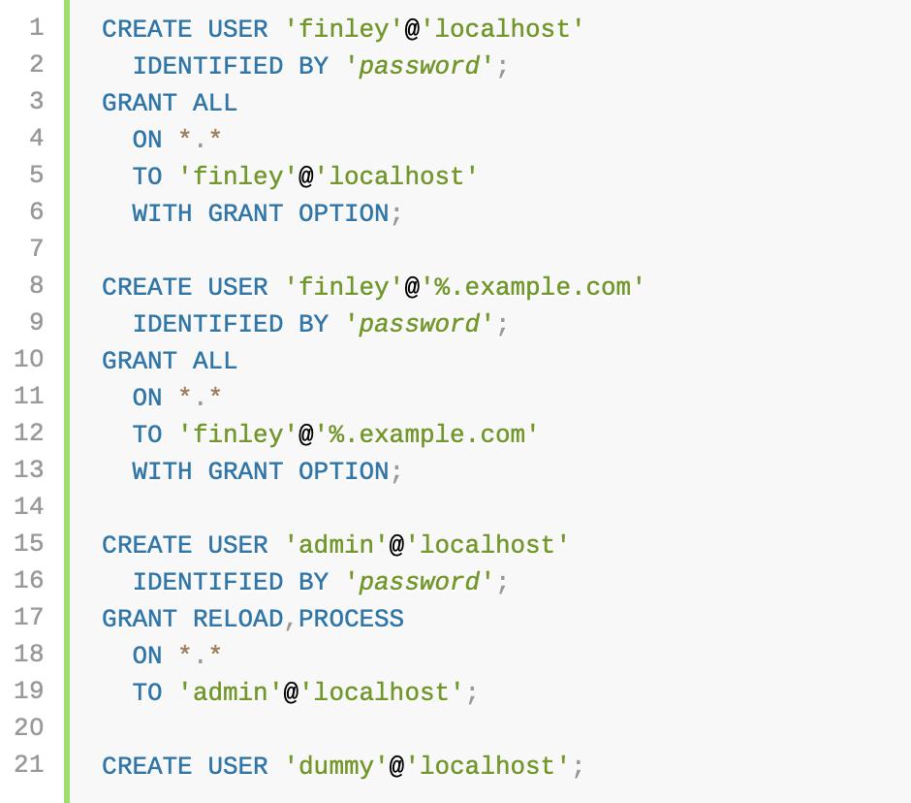
ACCOUNT REVIEW DOCUMENT

Slide 9
AC-5 SEPARATION OF DUTIES

Slide 10
AC-5 SEPARATION OF DUTIES
Making sure that security personnel installing access control, does not have access to audit functions.
Performing information system support functions with different authorized users , such as configuration management, programming, etc.
By separating duties and checking them with different authorized users, checks and balances
No single authorized users will have access, various personnel will be checking the system.
By separating duties, organization reduces the chances of misusing authorized privileges.

Slide 11
USERS
In Users we have created Maintenance Admin, Database Designer and User Admin and given them their respective grants and privileges.

Slide 12
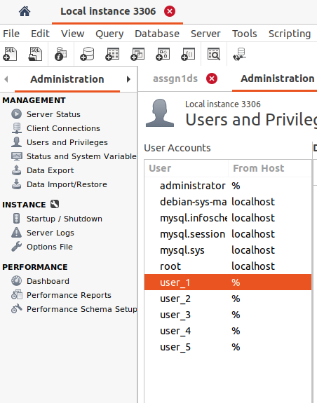
CREATING 5 USERS

Slide 13
USER ADMIN
Role Description:
User Admin will construct databases for storing data and allowing users to interact with it.

Slide 14
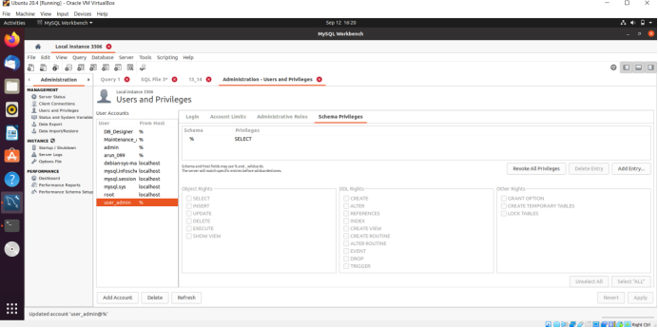
SCHEMA PRIVILEGES

Slide 15
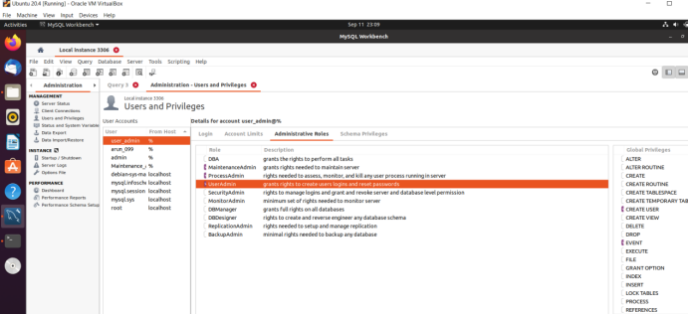
ADMINISTRATIVE ROLES

Slide 16
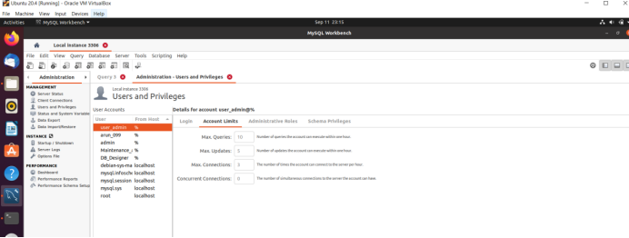
ACCOUNT LINKS

Slide 17
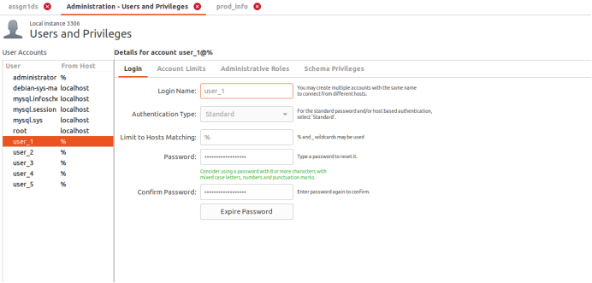
User_1 : ACCOUNT LOGIN

Slide 18
User_1 : SCHEMA PRIVILEGES

Slide 19
User_1 : ADMINISTRATIVE ROLES

Slide 20
User_1 : ACCOUNT LINKS

Slide 21
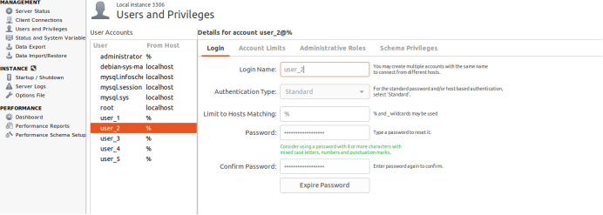
User_2 : ACCOUNT LOGIN

Slide 22
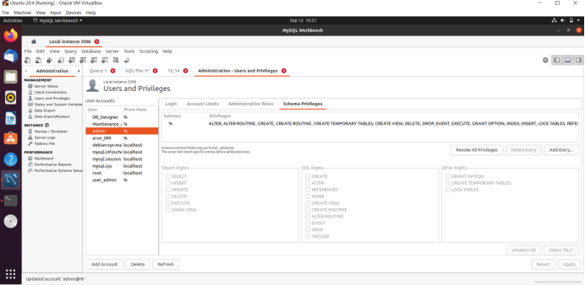
User_2 : SCHEMA PRIVILEGES

Slide 23
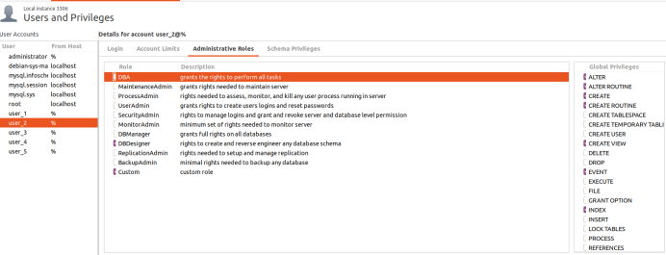
User_2 : ADMINISTRATIVE ROLES

Slide 24
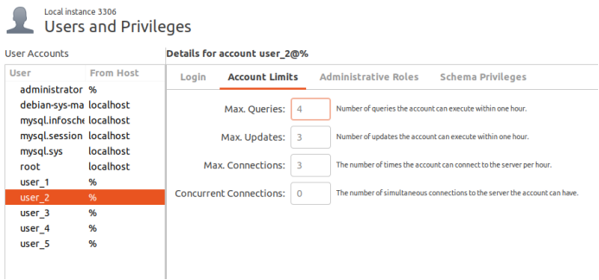
User_2 : ACCOUNT LINKS

Slide 25
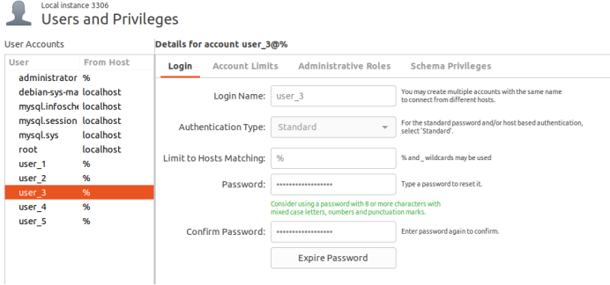
User_3 : ACCOUNT LOGIN

Slide 26
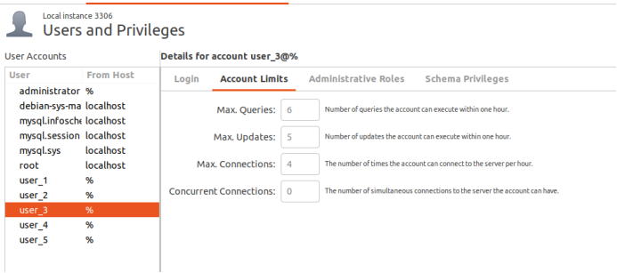
User_3 : Account Limits

Slide 27
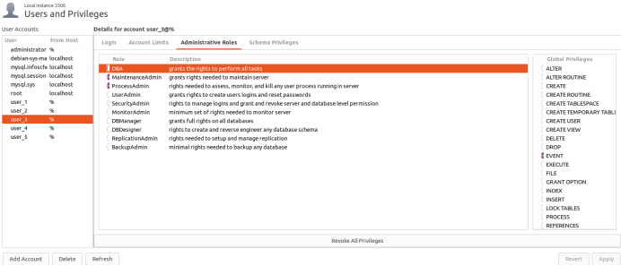
User_3 : Administrative Roles

Slide 28
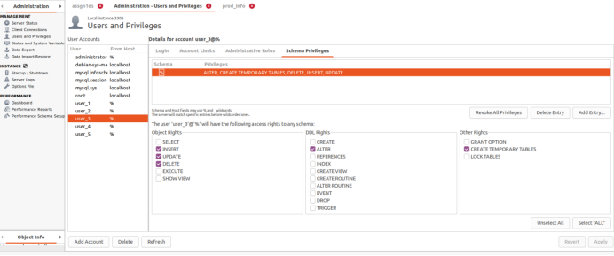
User_3 : Schema Privileges

Slide 29
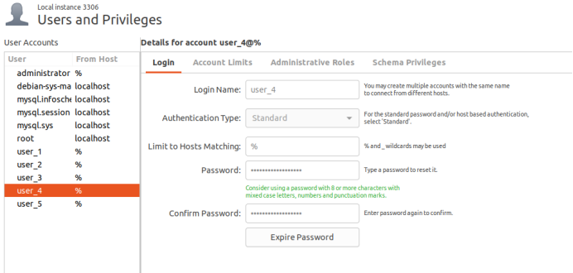
User_4 : ACCOUNT LOGIN

Slide 30
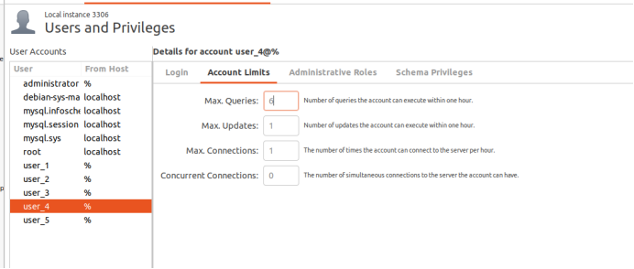
User_4 : ACCOUNT LIMITS

Slide 31
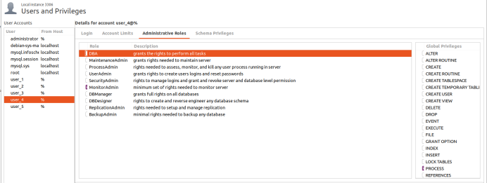
User_4 : ADMINISTRATIVE ROLES

Slide 32
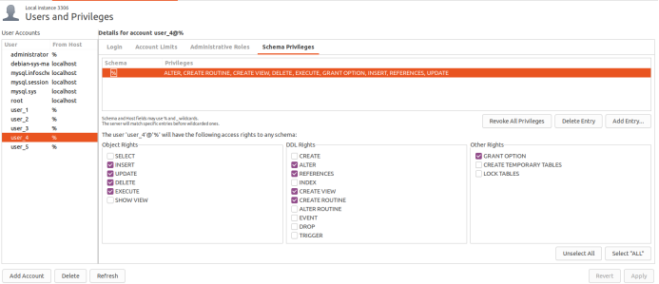
User_4 : SCHEMA PRIVILEGES

Slide 33
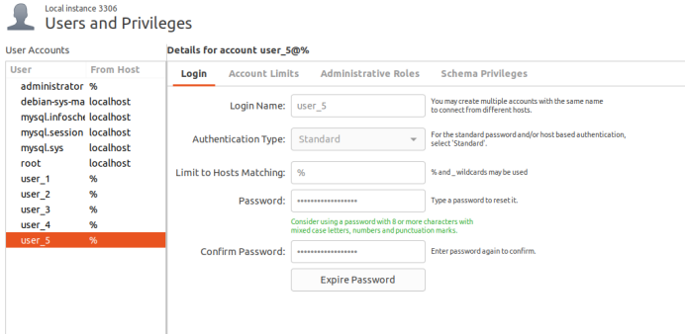
User_5 : ACCOUNT LOGIN

Slide 34
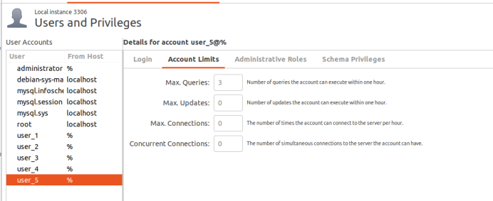
User_5 : ACCOUNT LIMITS

Slide 35
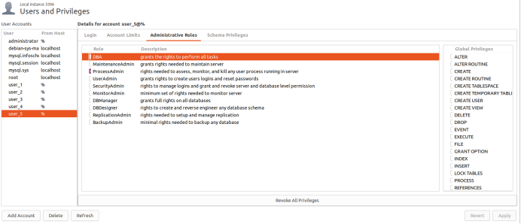
User_5 : ADMINISTRATIVE ROLES

Slide 36
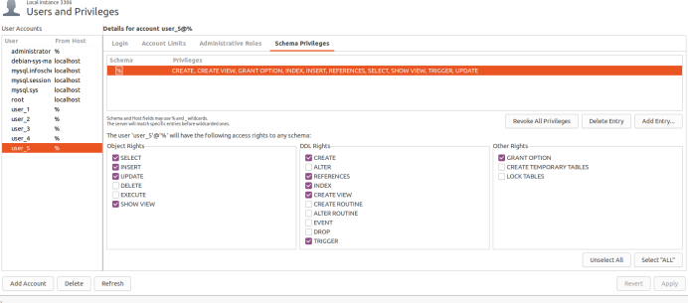
User_5 : SCEMA PRIVILEGES

Slide 37
AC-8 SYSTEM USE NOTIFICATION

Slide 38
AC-8 SYSTEM USE NOTIFICATION
Displays to users a message before granting access to the system that provides privacy and security notices consistent with applicable federal laws, Executive Orders, directives, policies, regulations, standards, and guidance and states that:
Users are accessing a U.S. Government information system;
Information system usage may be monitored, recorded, and subject to audit;
Unauthorized use of the information system is prohibited and subject to criminal and civil penalties; and
Use of the information system indicates consent to monitoring and recording;
Retains the notification message or banner on the screen until users acknowledge the usage conditions and take explicit actions to log on to or further access the information system

Slide 39

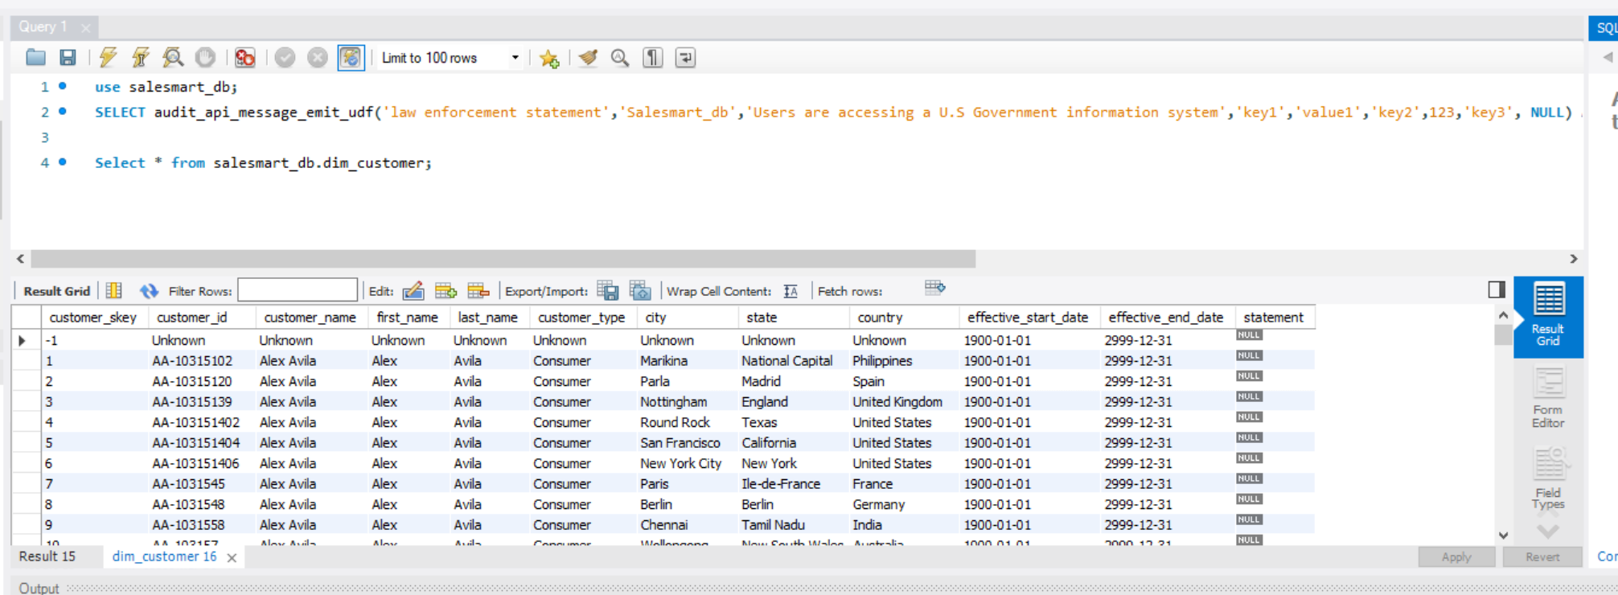
message creation + database view

Slide 40
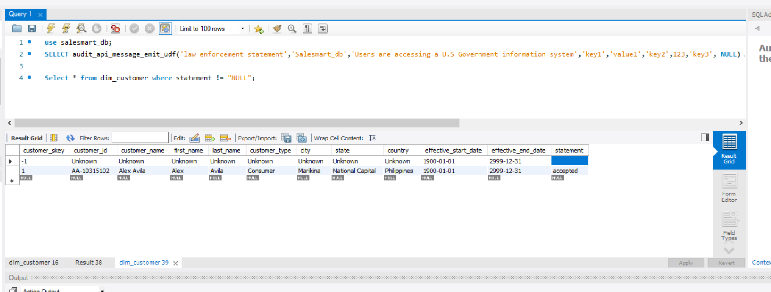
message accepted

Slide 42
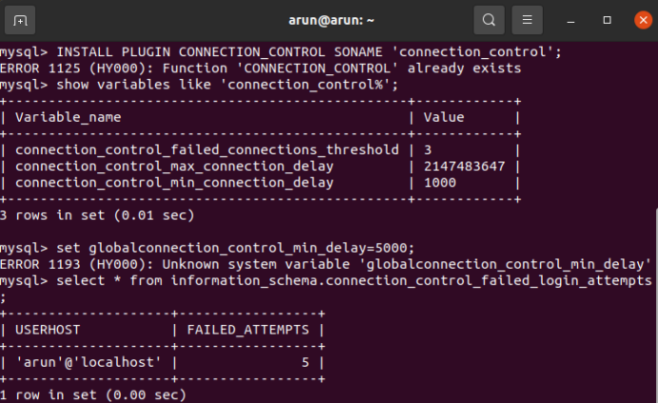
AC-7 UNSUCCESSFUL LOGON ATTEMPTS
System gets lock down for certain period of time , which is defined by the organization. The system administrator needs to unlock the account.
By placing this control , users will have set number of login attempts defined by organization. If they passes that limit, access get denied and system locks out the user.
This security control prevents the system from unauthorized, malicious users, whose intend is to damage and steal data.

Slide 43


Slide 44
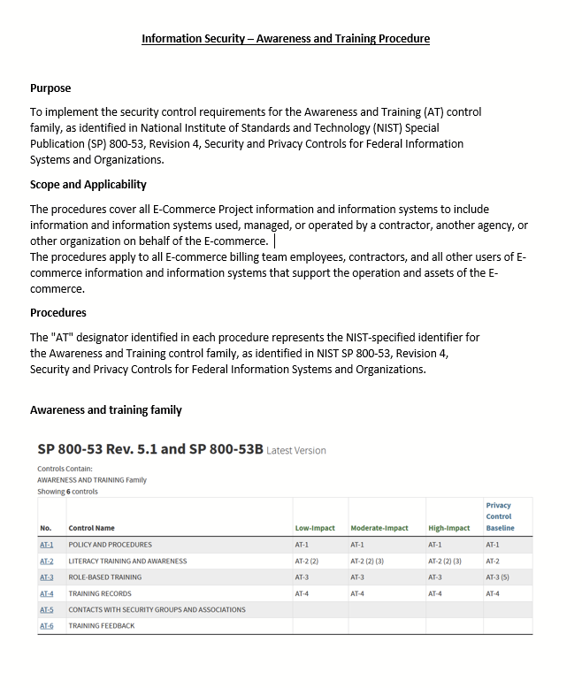
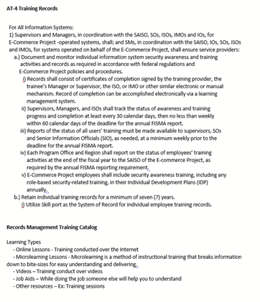
AT-4 SECURITY TRAINING RECORDS
Information Security- Awareness and Training Procedure
This document will include security control requirements for AT -4 Training records

Slide 45
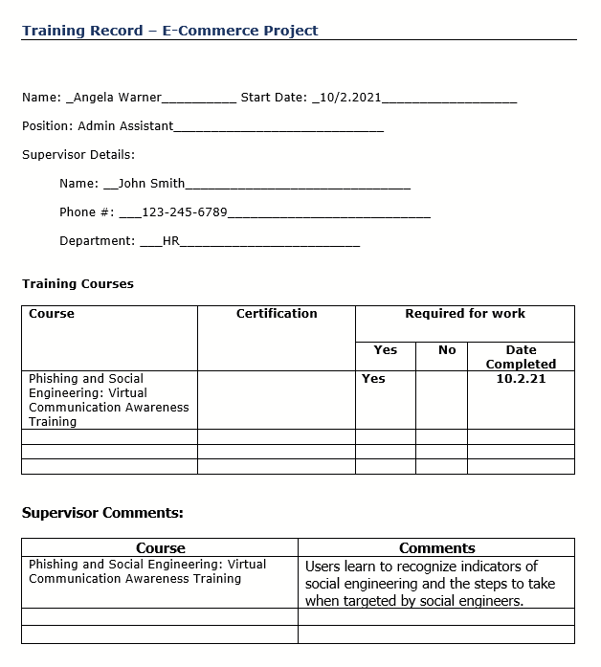
AT-4 SECURITY TRAINING RECORDS
Training Record
This document will help HR and/or Supervisors to document and monitor individual information systems security training activities including basic security awareness training and specific information security training.

Slide 46
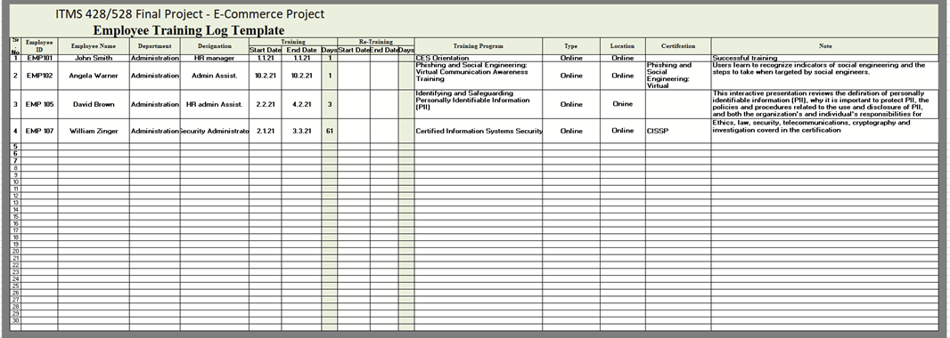
AT-4 SECURITY TRAINING RECORDS
Employee Training Log
Employee Training log is an excel template that helps you to record and manage employees under the training for upgrading their skills at any given point of time. In the training log you will have employee details, training schedule and training output.

Slide 47


Slide 48
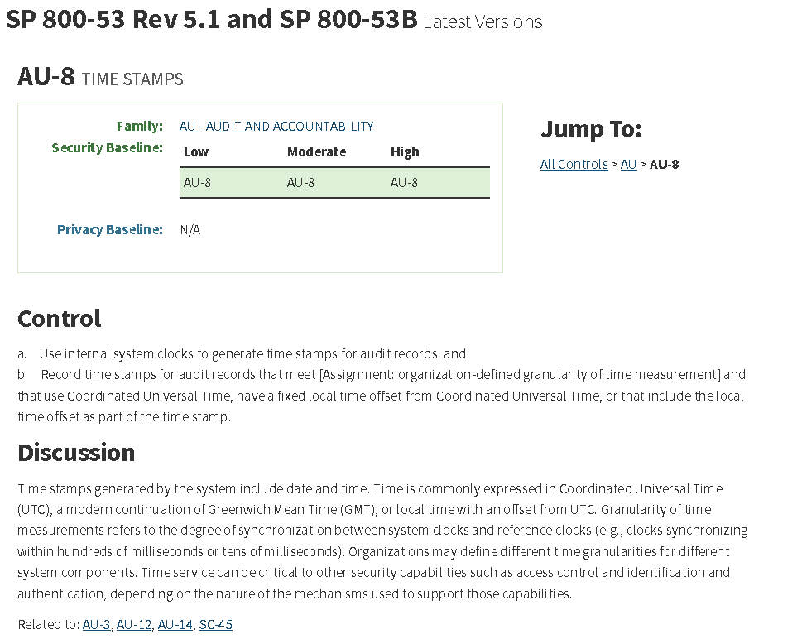
AU-8 TIME STAMPS
This document will include NIST Security Control requirements for AU-8.

Slide 49
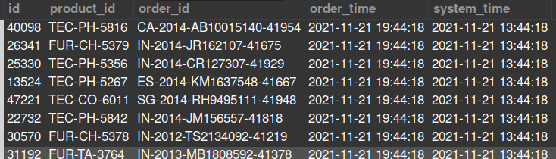
AU-8 TIME STAMPS - Setting Global Time Zone
To satisfy this NIST control requirement, which also acts as a form of auditing, I added two data fields one specifying the time of my local machine, and the other specifying Coordinated Universal Time (UTC)
order_time -> local time
system_time -> utc time

Slide 50
CA-5 PLAN OF ACTION AND MILESTONES

Slide 51
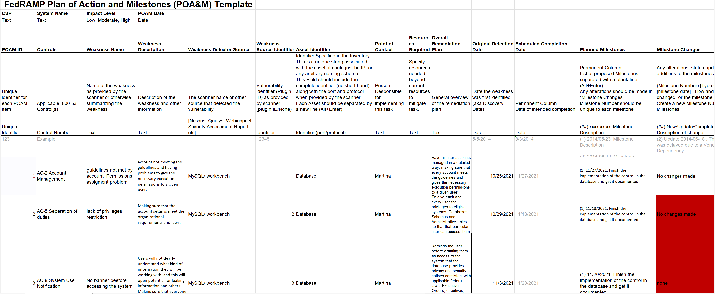
CA-5 PLAN OF ACTION AND MILESTONES

Slide 52
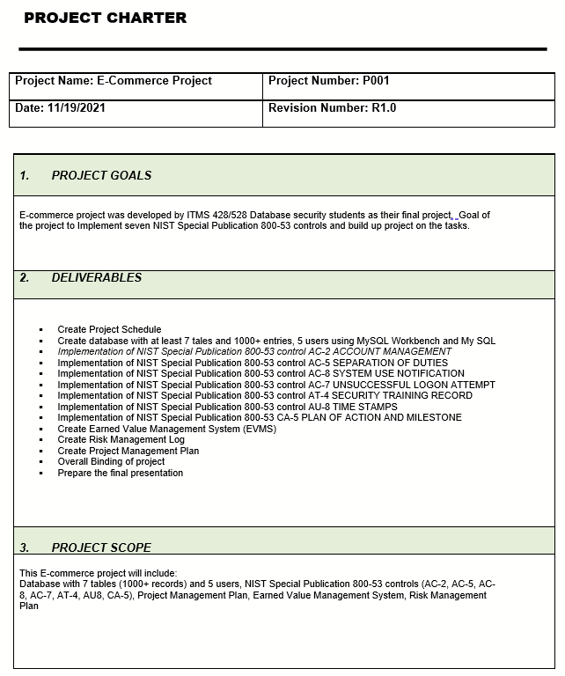
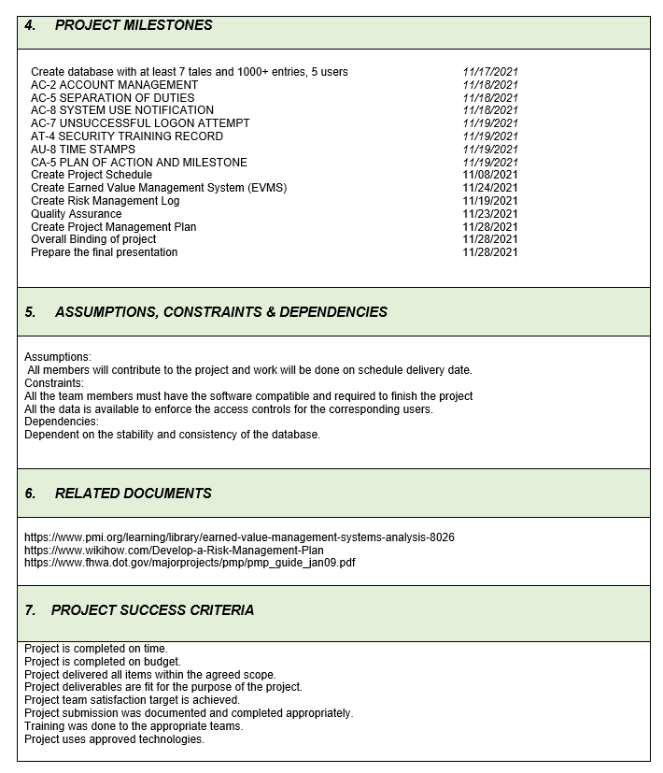
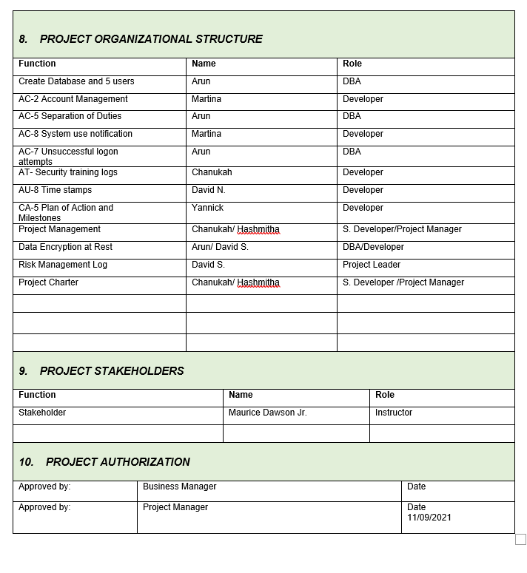
PROJECT CHARTER
A project charter is a short document that explains the project in clear, brief wording for high level management. Project charters outline the whole of projects to help teams quickly understand the goals, tasks, timelines, and stakeholders

Slide 53
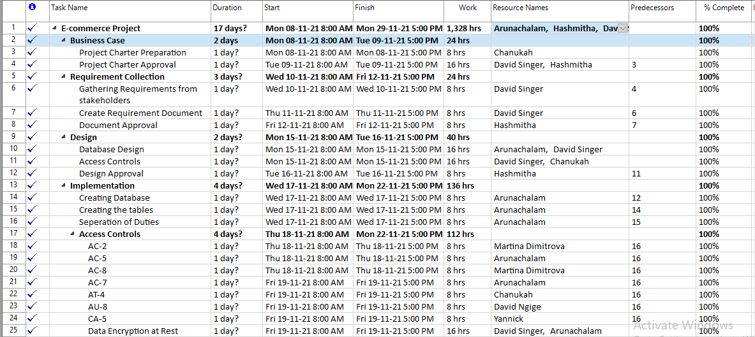
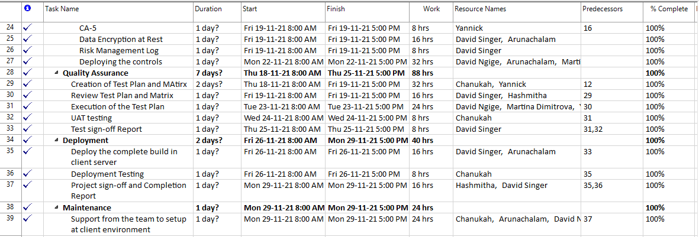
PROJECT SCHEDULE

Slide 54
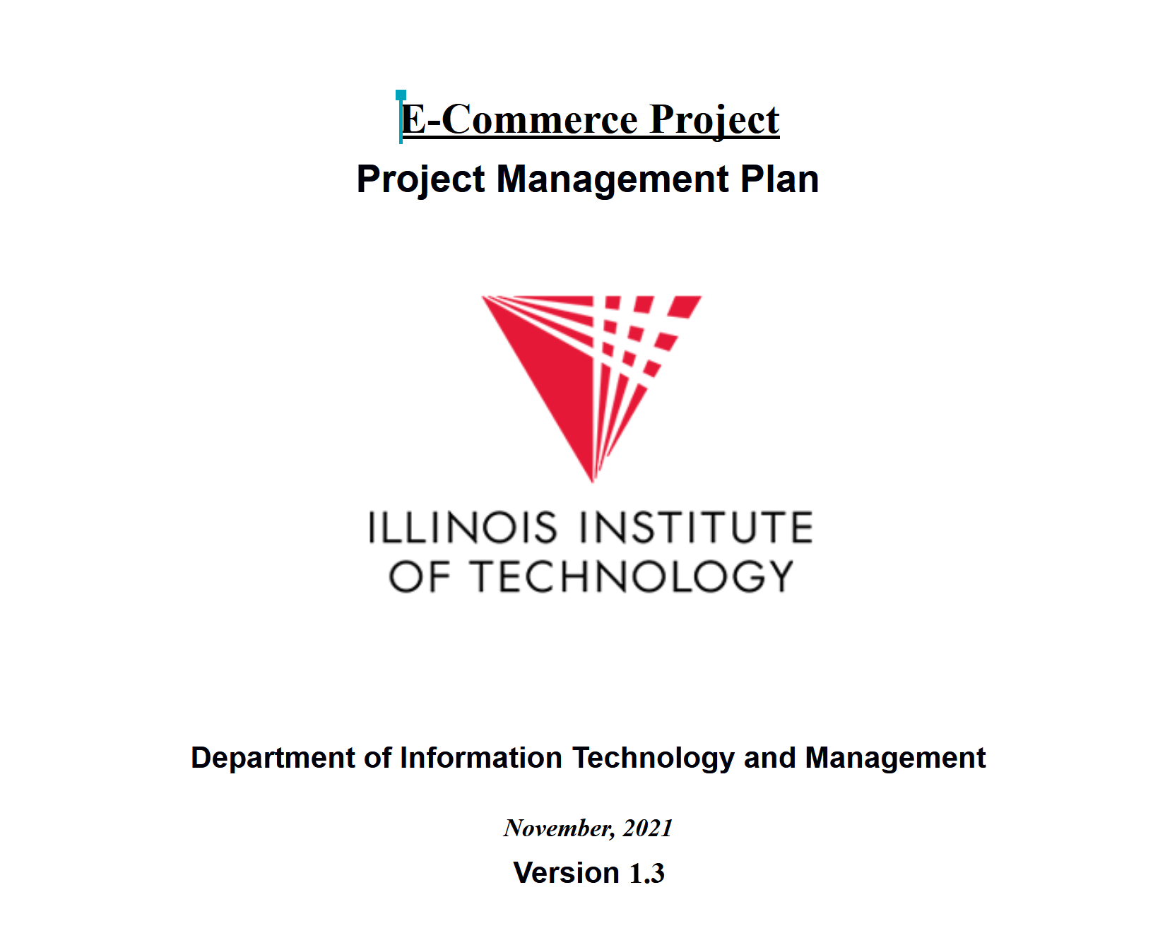
PROJECT MANAGEMENT PLAN (PMP)

Slide 55
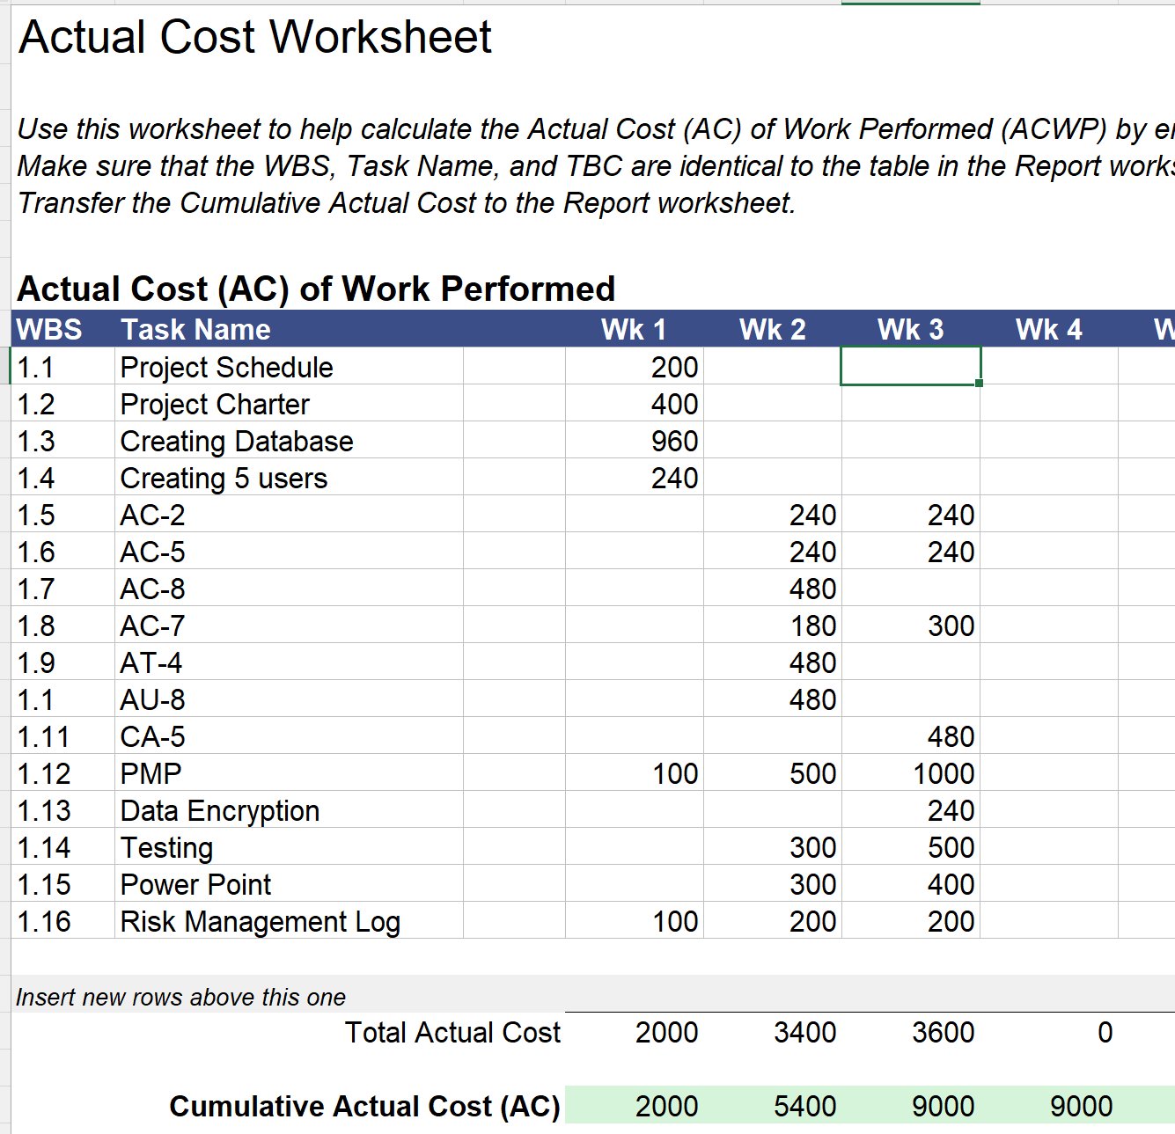
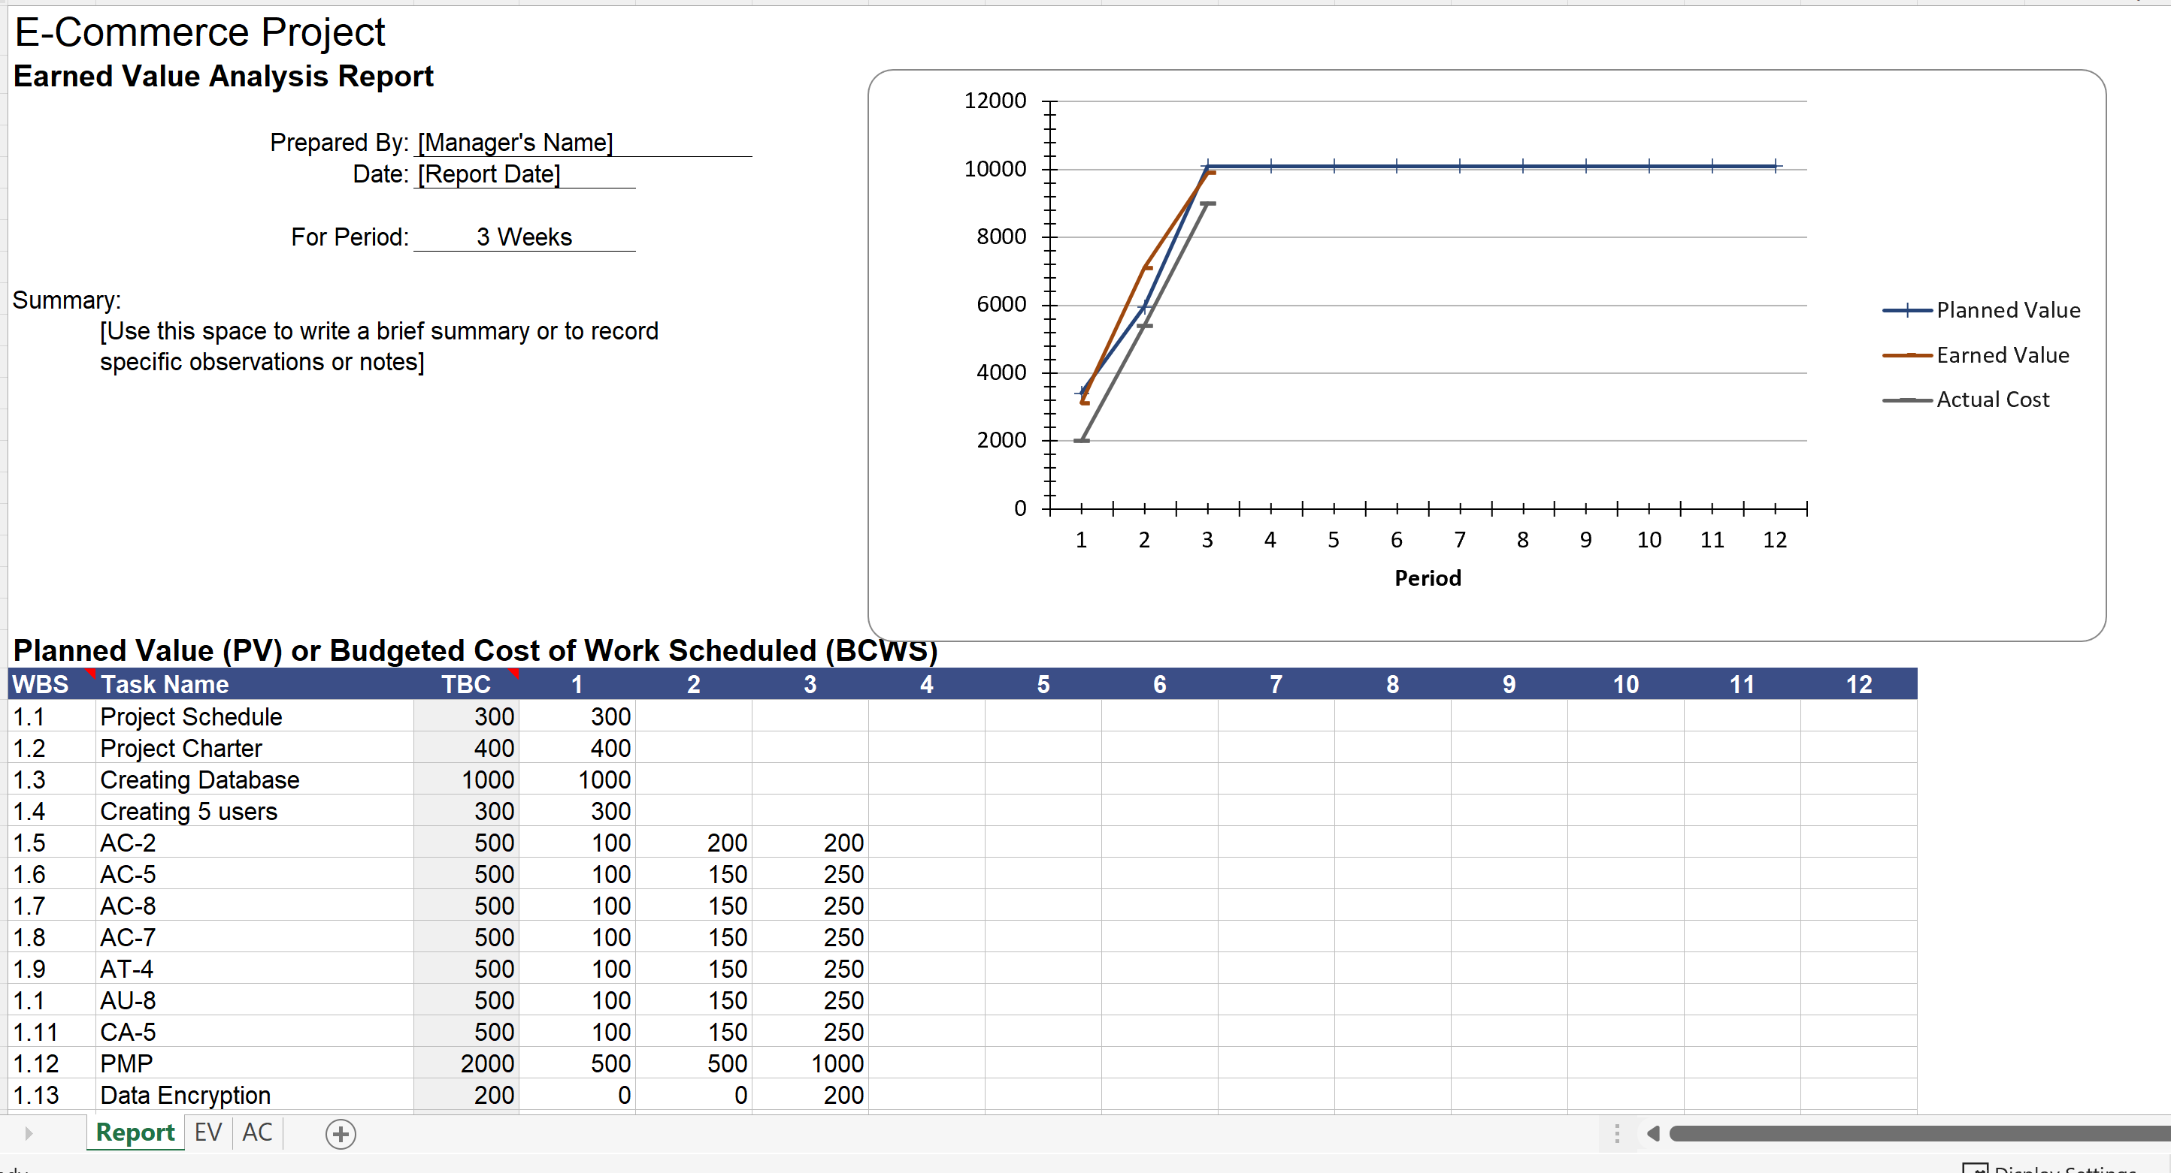
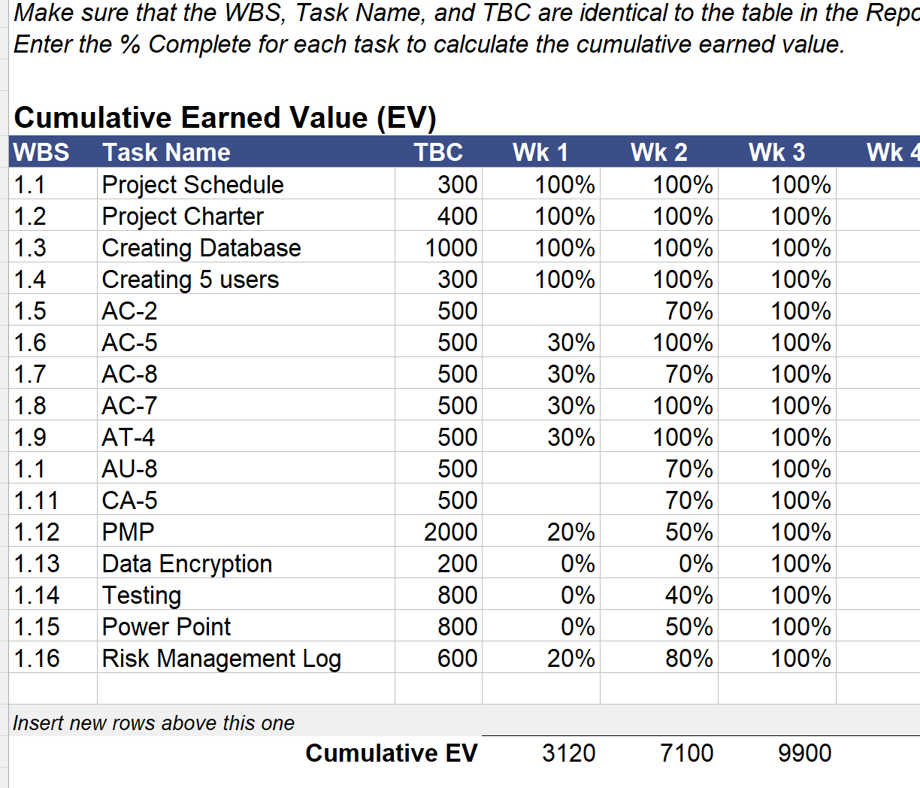
EARNED VALUE MANAGEMENT SYSTEM (EVMs)

Slide 56
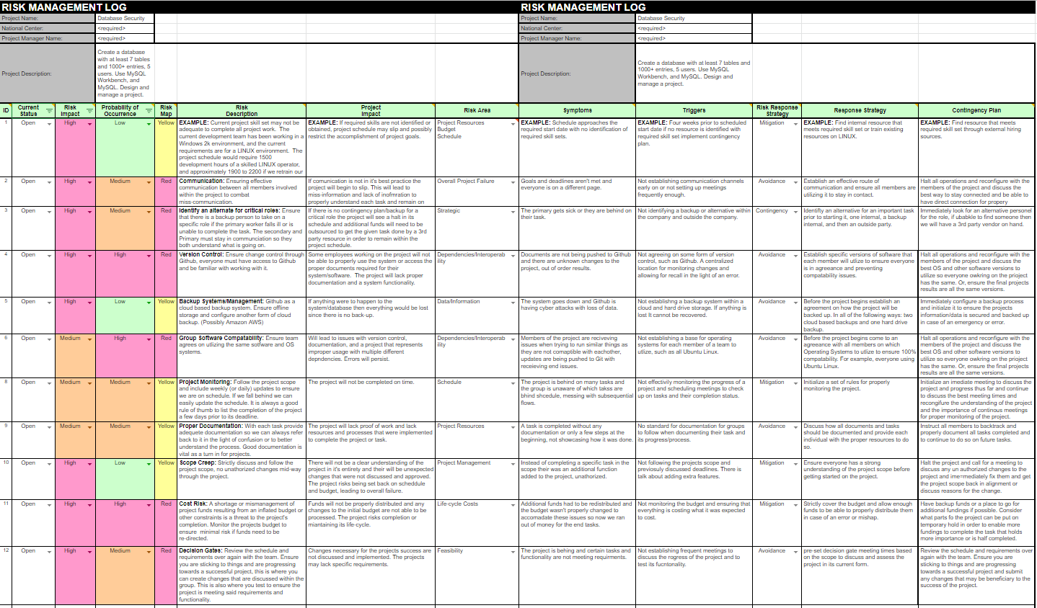
RISK MANAGEMENT LOG

Slide 57
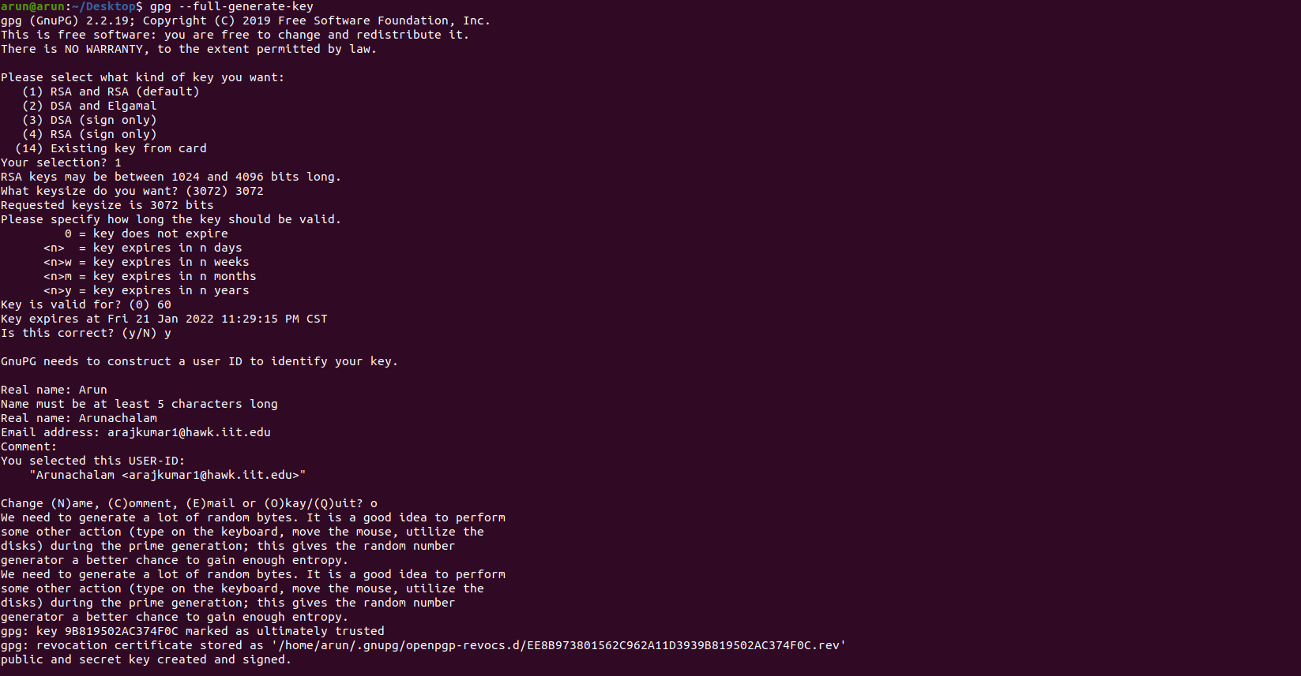
ENCRYPTING DATA AT REST USING GPG

Slide 58
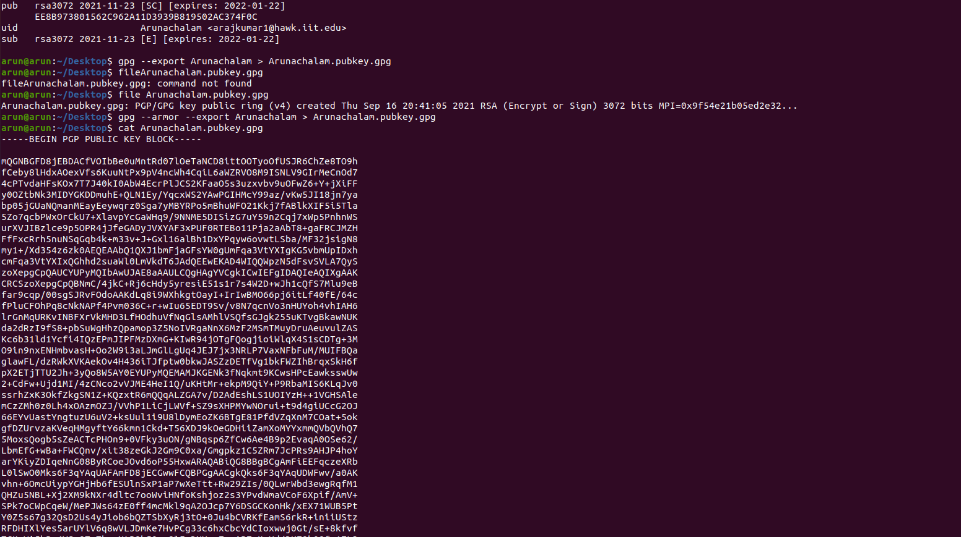
ENCRYPTING DATA AT REST USING GPG

Slide 59
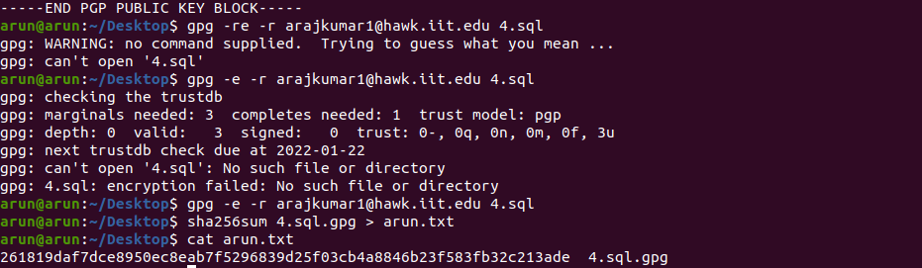
ENCRYPTING DATA AT REST USING GPG

Slide 60
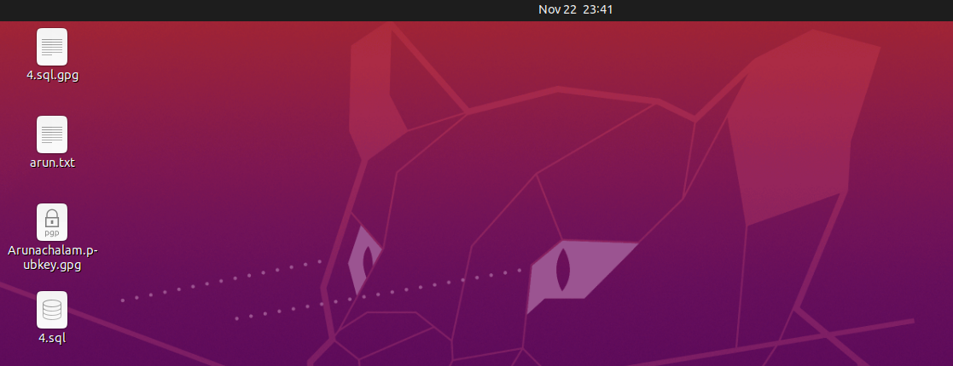
Files after Encrypting 4.sql file using gpg
ENCRYPTING DATA AT REST USING GPG

Slide 61
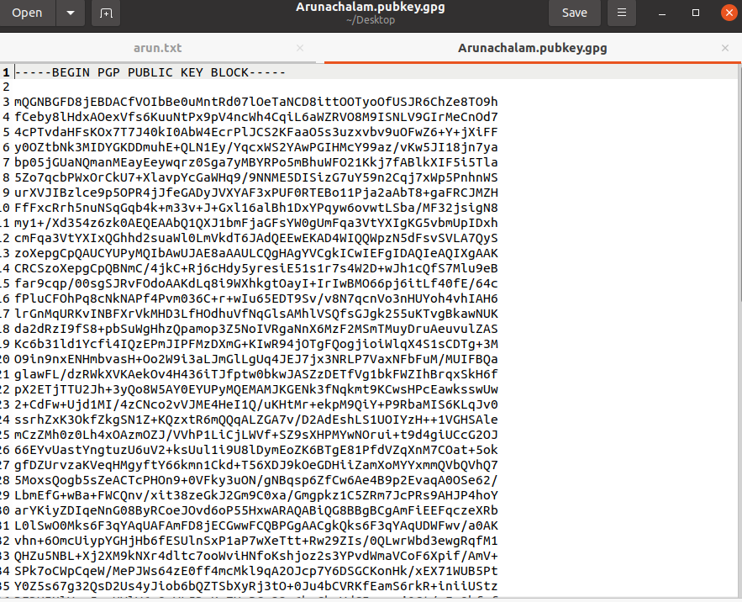

Keys Generated using gpg
ENCRYPTING DATA AT REST USING GPG

Slide 62

Questions

Slide 63


